Slide 1
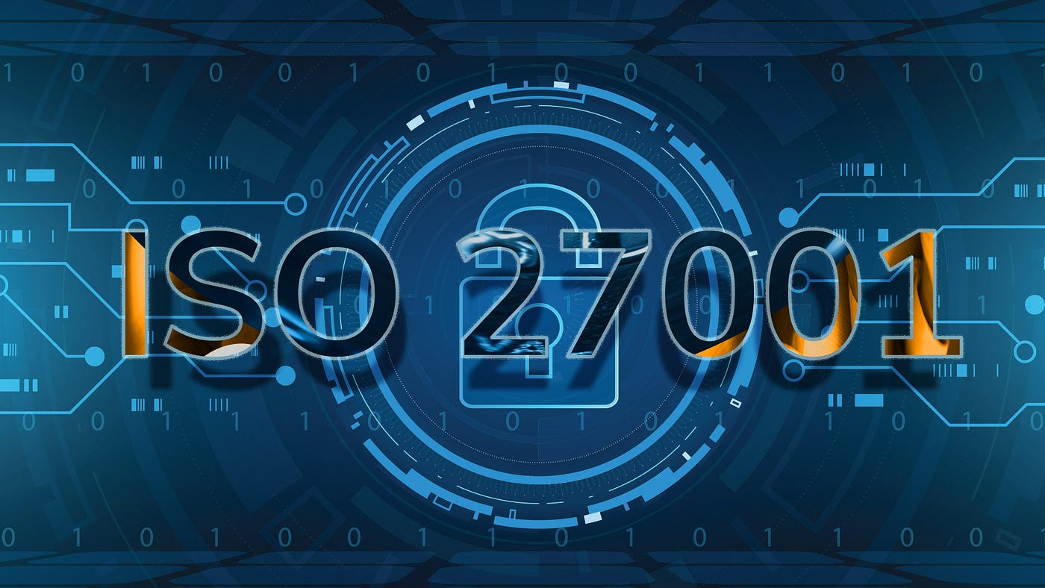

Slide 2
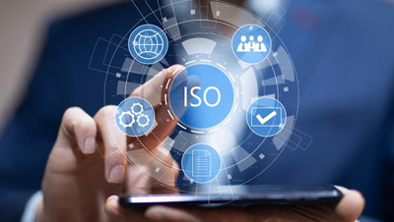
Introduction
Introduction
ISO 27001 is a risk-based security standard used by organizations to reduce information theft.
It includes 14 sections with different criteria and control goals.
Accreditation signifies an organization's commitment to protecting data assets and adhering to laws and regulations.

Slide 3
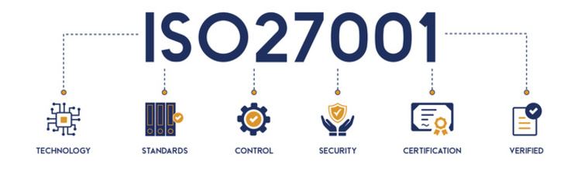
ISO 27001
ISO 27001 is a framework developed by ISO to guide the creation, implementation, and maintenance of information security management systems.
It covers documentation, managerial responsibility, internal audits, continuous improvement, and preventive measures.
ISO 27001 conformity doesn't require third-party certification, as specific controls depend on individual company risks.

Slide 4
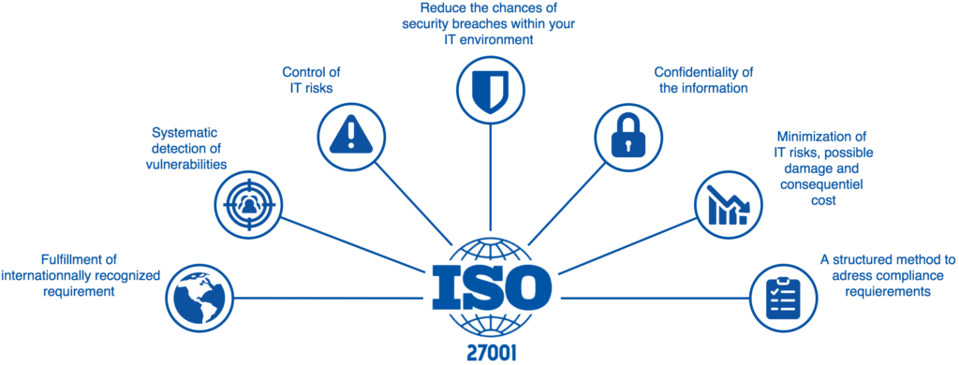
Why ISO 27001 is important
ISO 27001 certification is a globally recognized standard demonstrating data protection and expertise in Information Security Management Systems, which can be obtained by businesses, individuals, or through a course and exam.

Slide 5
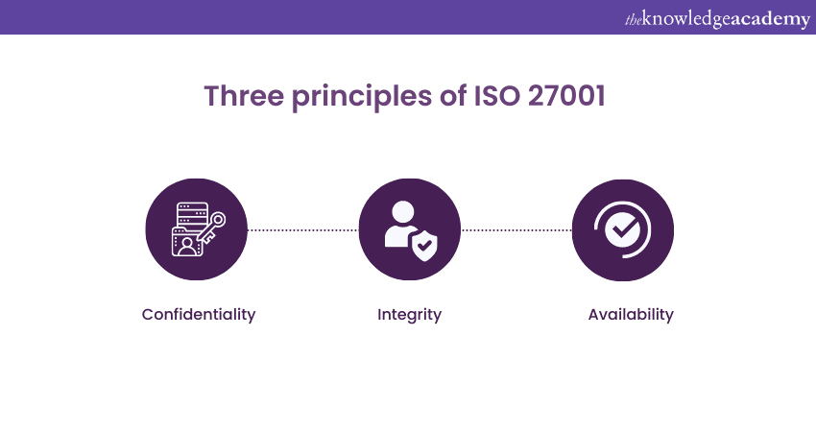
Principles of ISO 27001
Confidentiality
Integrity
Availability

Slide 6
Benefits of ISO 27001
Benifits of ISO 27001
Reduce the risks to information security and privacy.
Saving Time and Money
Enhances a Reputation and Fosters Organisational Trust
Competitive edge due to recognized standard
Control of IT risk
Lower costs
Systematic detection of vulnerabilities

Slide 7
Requirements of ISO 27001
Management Responsibility
Resource Management
Information Security
Measurements, Analysis and Improvement

Slide 8
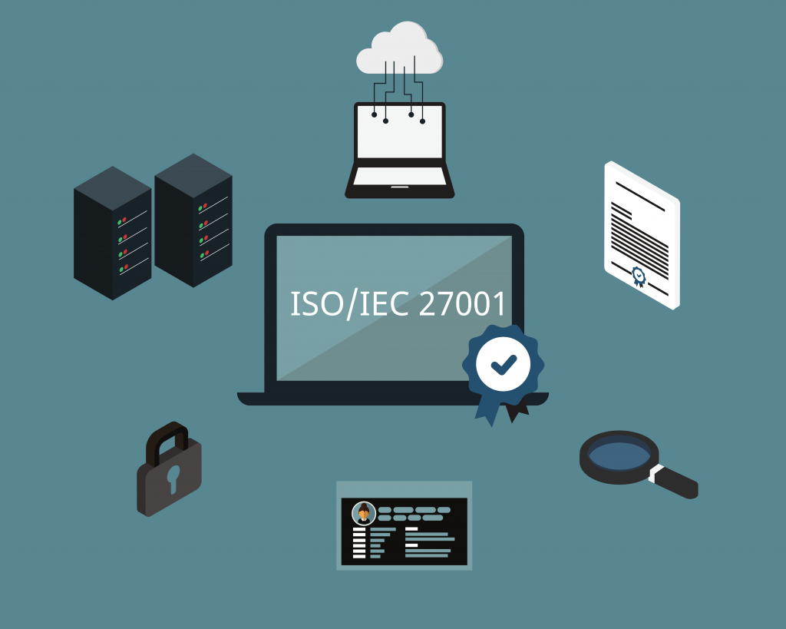
Who needs ISO 27001
Organizations must address threats like information theft, cybercrime, and privacy leaks.
The ISO/IEC 27001 standard allows businesses to develop tailored risk management strategies, affecting various sectors.
ISO/IEC 27001-certified companies integrate organizational processes, systems, and management controls with information security, improving efficiency and achieving industry top positions.

Slide 9
Thank You

